Slide 1

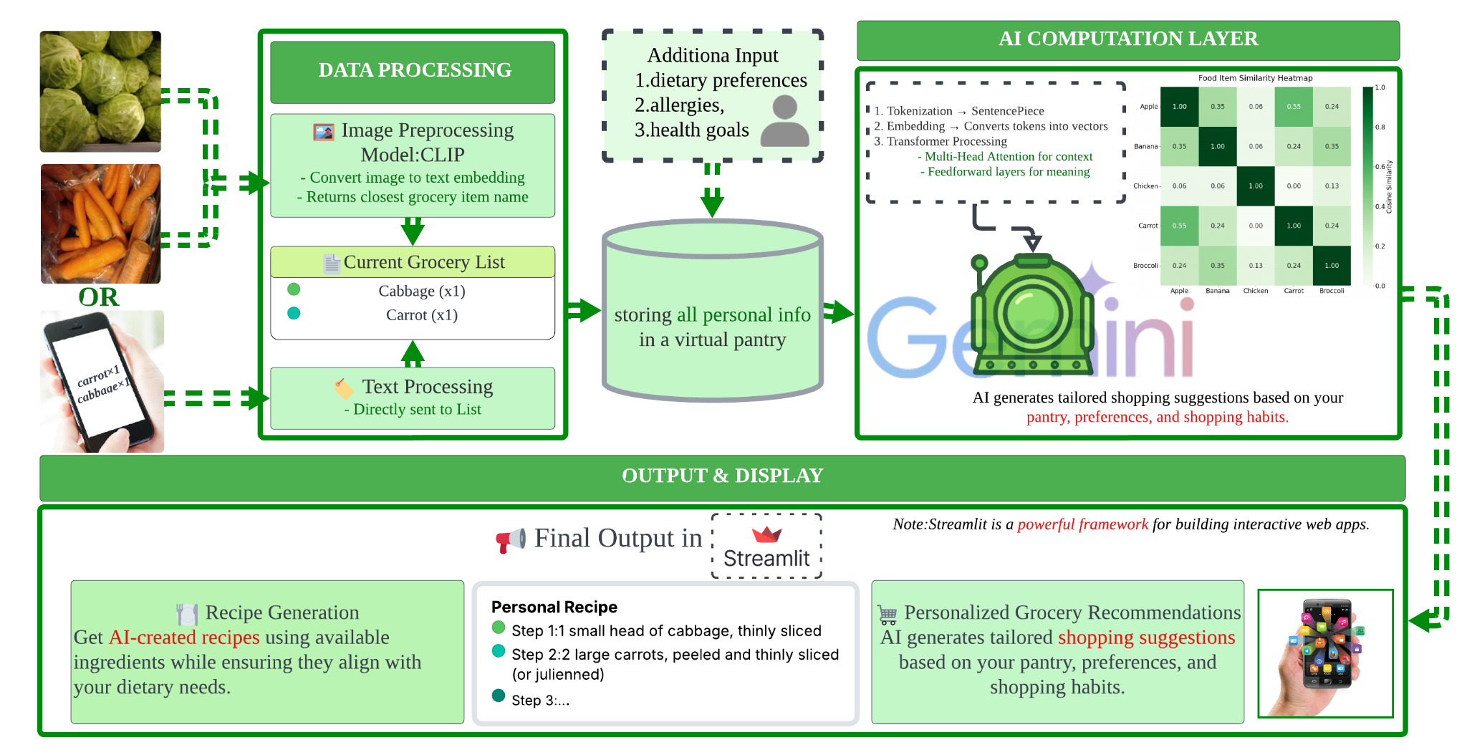
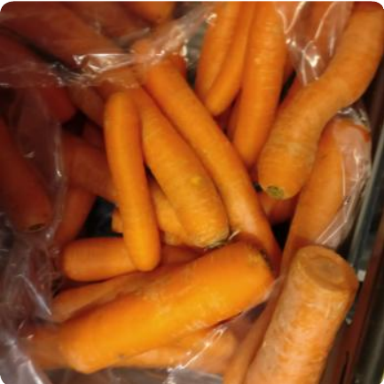
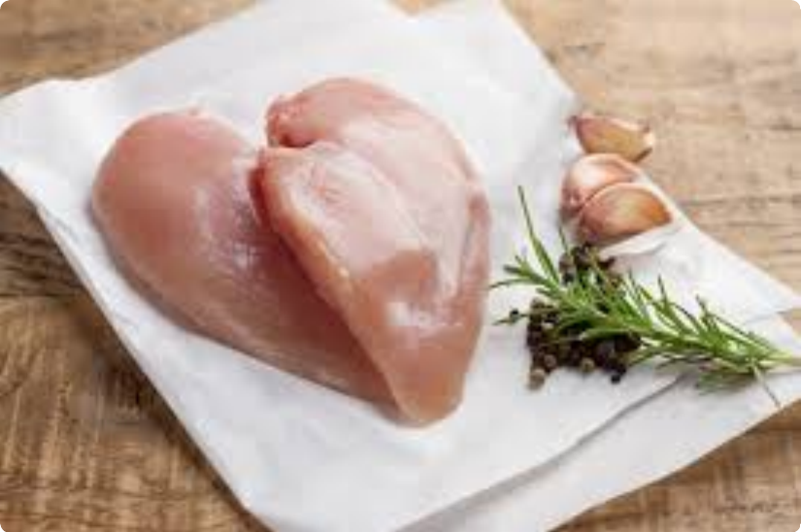
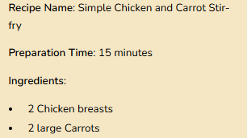
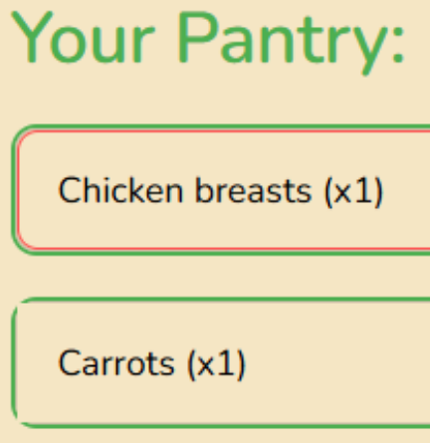

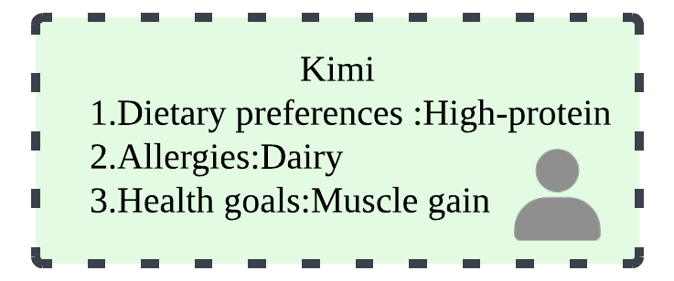
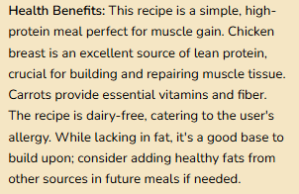
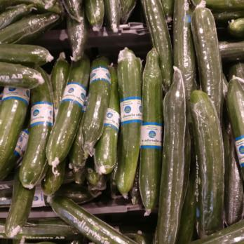
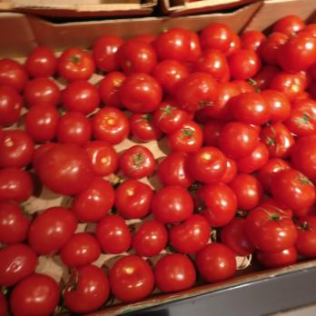
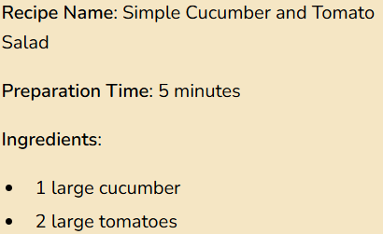
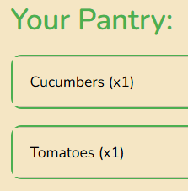
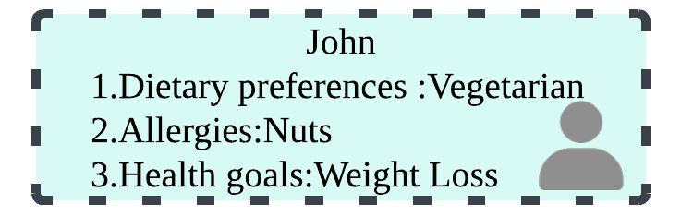
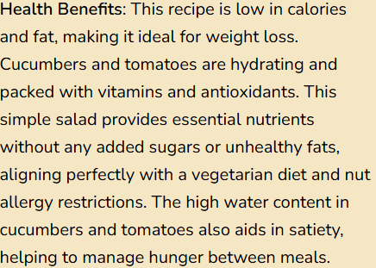
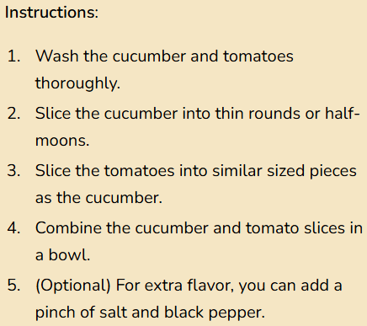
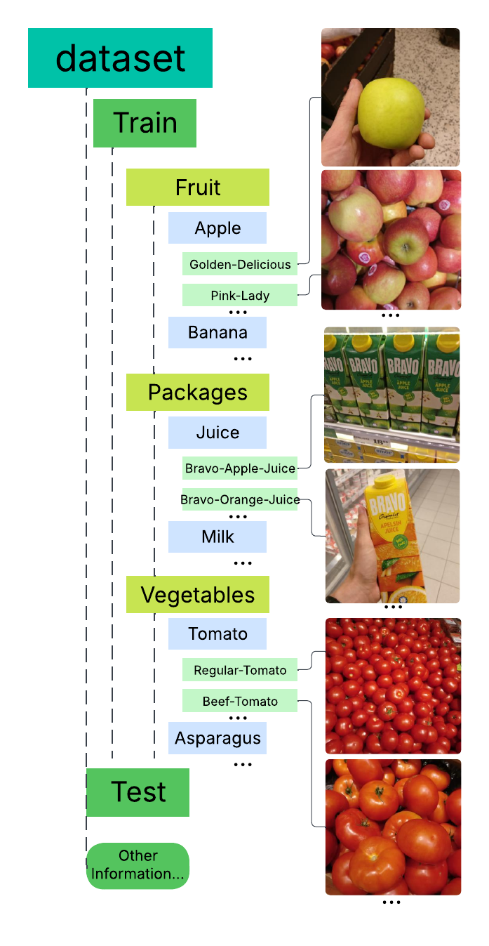

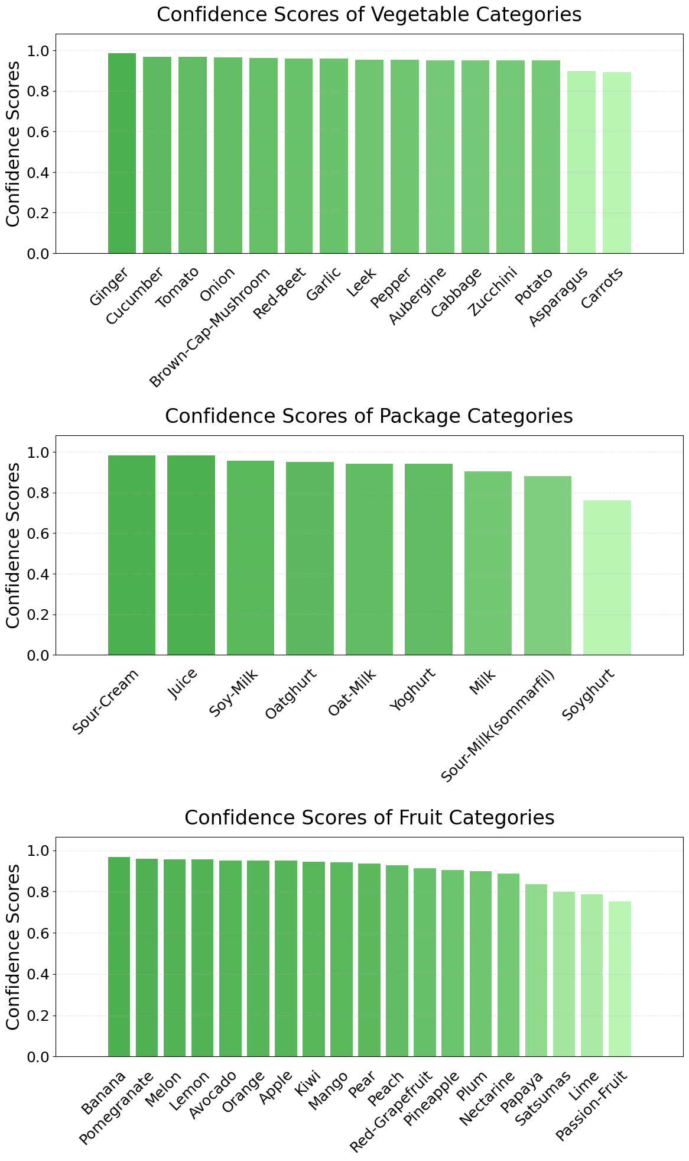
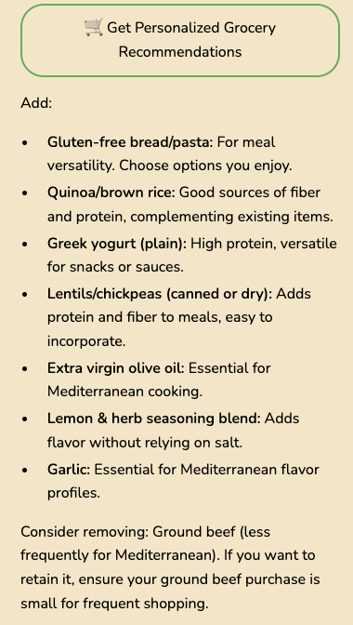
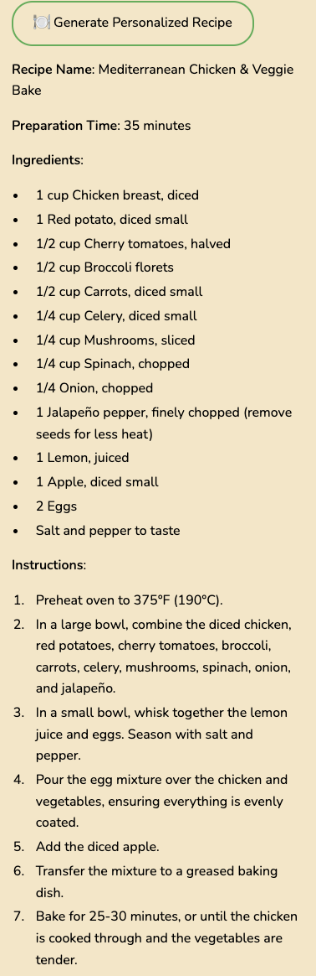
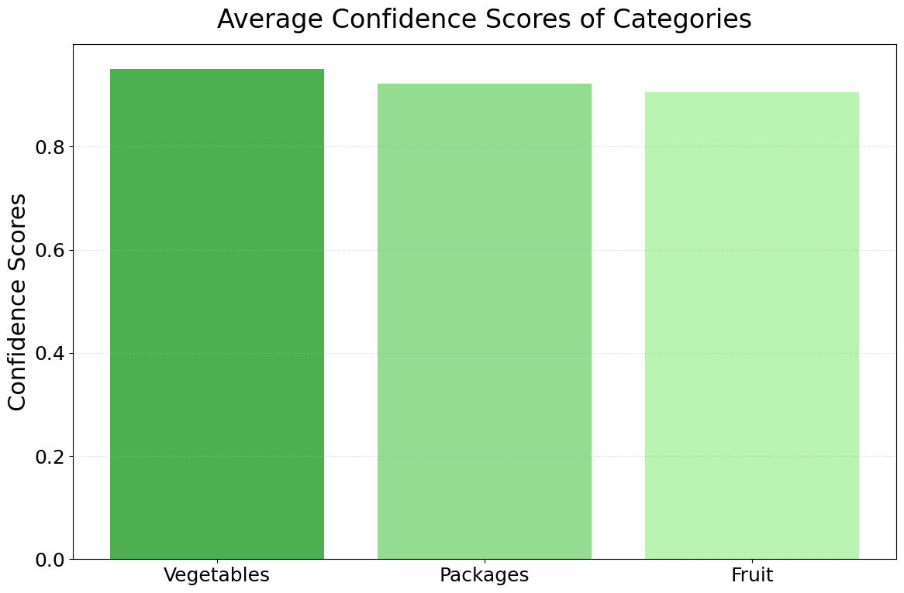
Grocery Tracker & Recommendation Generator
AI for Smarter Grocery Choices and Meal Planning
Katy Bohanan, Joan Rocha, Chuheng Xiao
Computer Science, University of Missouri - Kansas City
Introduction & Objectives
Methodology
More examples
Food waste, complex meal planning, and lack of nutritional awareness make grocery shopping a common pain point. This project introduces an AI-powered grocery management system to tackle these challenges.
Key features: The system utilizes image recognition for automatic inventory management, personalized recipe discovery, and comprehensive nutritional analysis.
Objectives:
Automated Inventory Management: Implement image recognition to automatically detect and track grocery items
Personalized Suggestions: Provide tailored recipe and shopping recommendations based on user preferences, dietary restrictions, and health goals
Enhanced Nutritional Awareness: Offer detailed nutritional information for each item, encouraging users to make informed dietary choices
How Our App Works？
Dataset
Grocery Store Dataset
It contains 5125 natural images from 81 fine-grained classes of grocery items (fruits, vegetables, carton products like juice, milk, yoghurt). These are grouped into 42 coarse-grained categories for hierarchical classification.
The dataset includes fine- and coarse-grained labels for each image, with paths and labels provided in train.txt, val.txt, and test.txt(as shown in the "Other information" section of the right image).
Mappings for the classes are available in classes.csv, which also contains iconic images and product descriptions.(also in “Other information”)
Conclusion & Future Vision
Fig 2: Methodology of our system
Key Findings
Developed a smart grocery management system using AI and image recognition.
Addressed common challenges such as food waste, meal planning, and lack of nutritional awareness
Impact:
Personalized grocery recommendations and recipe generation promote healthier eating and enhance user experience
Final Thoughts:
This project empowers users to make more informed and efficient grocery decisions with minimal effort.
Our future vision includes:
Integrating image generation to provider visual, step-by-step instructions for recipes, enhancing the cooking experience for users.
Offering enhanced nutritional analysis, providing more detailed health-focused feedback to help users meet their dietary goals.
Developing a fully optimized mobile version of the app, allowing users to manage their groceries and meal plans seamlessly from their phones.
Expanding the backend infrastructure using MongoDB to handle large volumes of user data, enabling efficient management of user profiles, their history, and personalized recommendations.
Results & Discussion
Ingredient Recognition Test
With prompt engineers' help, 's ingredient recognition accuracy has nearly reached 100%!
We then tested its confidence levels by classifying images into predefined categories and extracting the correct category's confidence score, with Gemini required to ensure the total equals 1.
For each item (e.g., apples), we averaged results over 10 tests, generating the charts
on the right.
We then averaged across broader categories for the chart below,
Fig 1: Grocery Store Dataset
References
Fig 4-6 (as shown)
Recipe Generation
screenshot
2021 - Combined machine learning with expert knowledge for nutrition goal recommendations (Mitchell et al.)
2021 - Artificial intelligence in nutrition research: perspectives on current and future applications (Côté & Lamarche)
2024 - Applications of AI, machine learning, and deep learning in nutrition: A systematic review (Theodore Armand et al.)
Acknowledgements
Acknowledgements
Dr. Yugyung Lee
CS5588 - Data Science Capstone Course
Fig 3: Average Confidence Scores of Categories

